Slide 1
LEAD SCORING CASE STUDY
By- Amaan Saifi

Slide 2
PROBLEM STATEMENT
A company namely, “X Education” specializes in providing online courses to industry professionals.
The company has listed the details of its course on various websites example Google.
The people land on these websites and search for the courses in which they are interested.
Thus leads are generated through Emails, site visit, google searches, advertisements.
Although X Education generates a lot of leads but only 30% are converted.
The company wants to identify HOT LEADS or Promising Leads so as to improves the conversion which in turn will improve the efficiency.

Slide 3
Business Agenda
The company needs a model which can select the most promising leads out of the Leads pool.
Every individual Lead should be allotted a score which indicates how promising it is to convert. The higher the lead score is the more promising it will be hence can be called HOT LEAD.
The new lead conversion rate should be around 80%.

Slide 4
Strategy
Import Libraries
Exploratory Data Analysis
Preparing Data for modeling
Building a logistic regression model
Testing the model on Train dataset
Evaluating the Model
Testing the model on Test dataset
Assigning a Lead score
Conclusion

Slide 5
Exploratory Data Analysis
Data understanding - Checking for the categorical and numerical columns in data and checking for outliers.
Data cleaning -Removing unnecessary columns
Replacing “Select” label in some columns with null values. Select label means that the responder hasn’t selected any option.
Dropping columns having more than 35% null values.
Now, Imputing the missing values in the columns with respective Mode values.
Created Visualizations to analysed variables

Slide 6
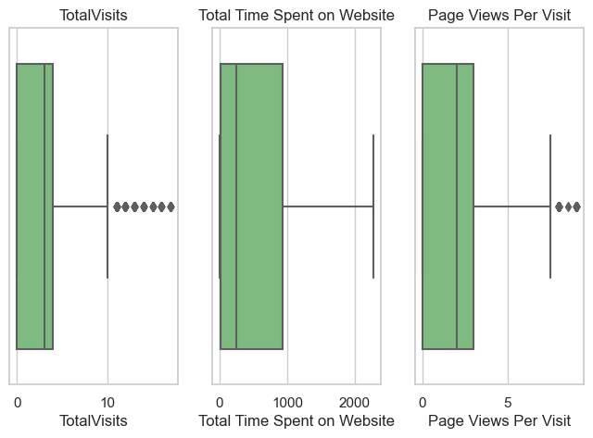
Outliers
We can say that 'TotalVisits' & 'Page Views Per Visit' & 'Total Time Spent on Website' have outliers in them and we need to treat them to make our dataset ﬁt for the analysis.
Outlier Treatment: Remove top & bottom 1% of the Column Outlier values

Slide 7
Data Preparation for modeling
Converting Yes/No to Binary variables and correcting datatype of Page Views Per Visit and TotalVisits.
Creating dummy variables for the 8 categories and dropping the ﬁrst level.
Splitting the data in Train and Test sets.
Feature Standardizations of numerical data.
Initial conversion rate was found to be 38.45%.

Slide 8
Model Building
Eliminating insigniﬁcant features through RFE.
Then removed features manually by checking p-values and VIF.
Determined optimal model using Logistic regression.
5th Model was ﬁnalised as optimal.

Slide 9
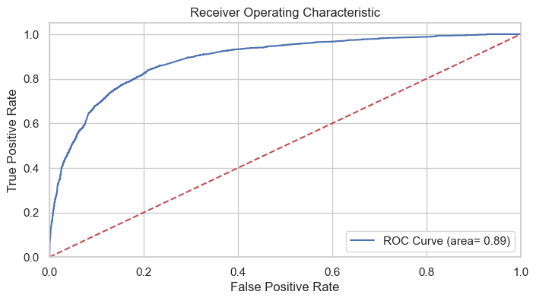
Prediction Train dataset
ROC Curve Plotting -
ROC curve shows the trade-off between sensitivity and speciﬁcity - means if sensitivity increases speciﬁcity will decrease.
The curve closer to the left side border then right side of the border is more accurate.
The curve closer to the 45-degree diagonal of the ROC space is less accurate.
Points to be noted from the ROC Curve
The curve is closer to the left border than to the right border hence our model is having great accuracy.
The curve area is 89% of the total area.

Slide 10
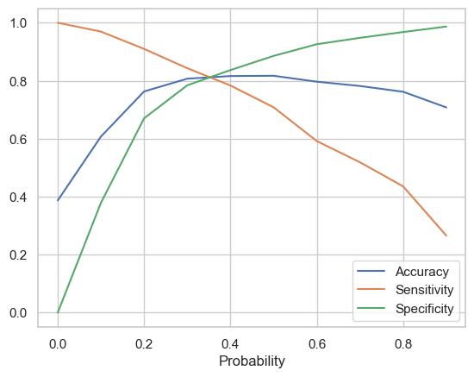
Model Evaluation
It was found that 0.36 is perfect for the probability cutoff.
Through this cutoff we got:
Accuracy=81%
Sensitivity=81%
Specificity= 82%

Slide 11
Model Evaluation
Calculated Accuracy, Sensitivity and Speciﬁcity.
Found Precision and Recall score;
Train datasets ~ 73% and 81% respectively.
Test datastets ~ 71% and 79% respectively.

Slide 12
Conclusion
The Accuracy, Precision and Recall scores we got from the test data are in the acceptable region.
Important features responsible for good conversion rate or the ones' which contribute more towards the probability of a lead getting converted are:
Total Time Spent on Website
Lead Origin_Lead Add Form
What is your current occupation_Working Professional

